Slide 1
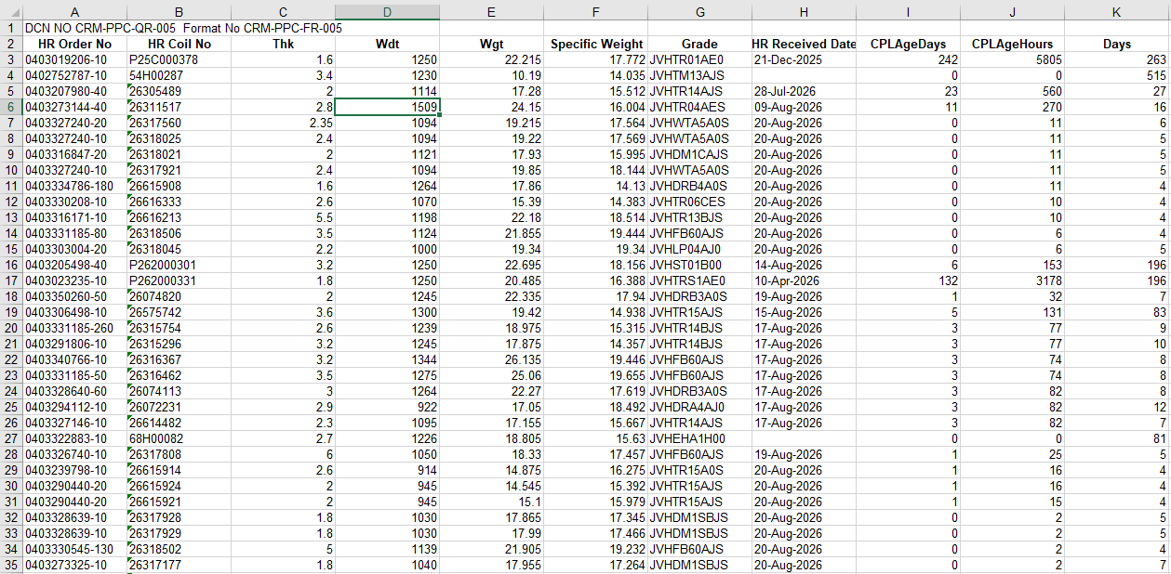
STEP 1:
DELETE 1ST COLUMN & ROW

Slide 2
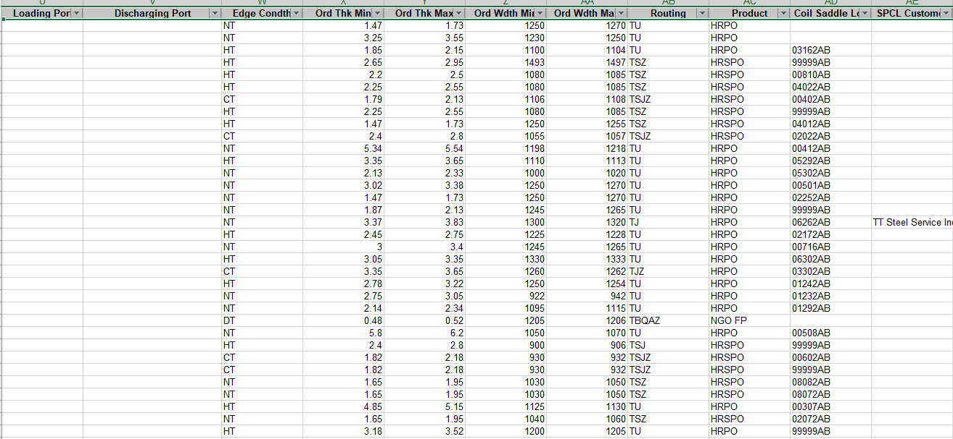
Step 2: Apply filter & in Product (select HRPO/HRSPO/NGOFP)

Slide 3
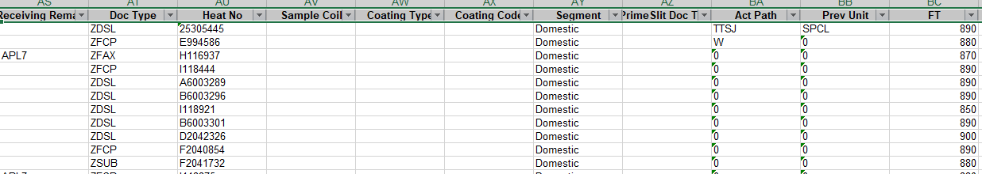
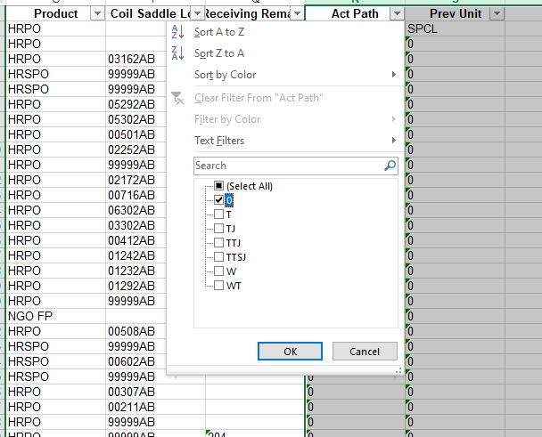
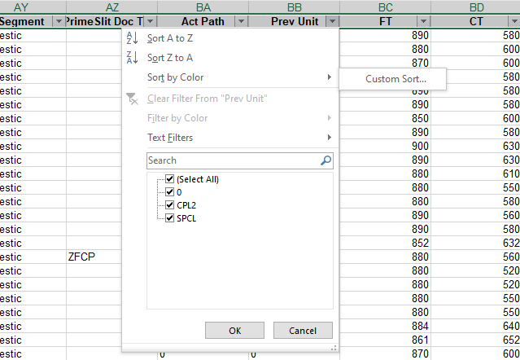
Step 3: Select Act Path & Prev Unit
Step 4: Select only zero

Slide 4
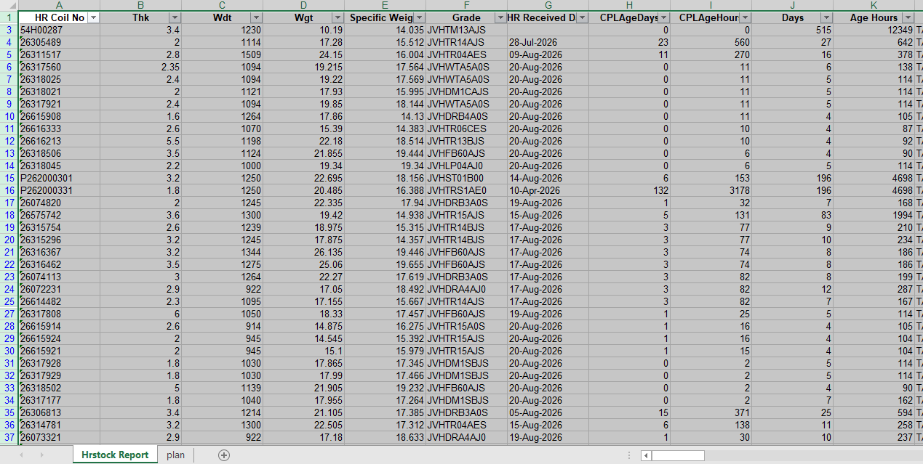
Step 5: Copy the Data & paste in Plan sheet
Main sheet
Planning sheet

Slide 5
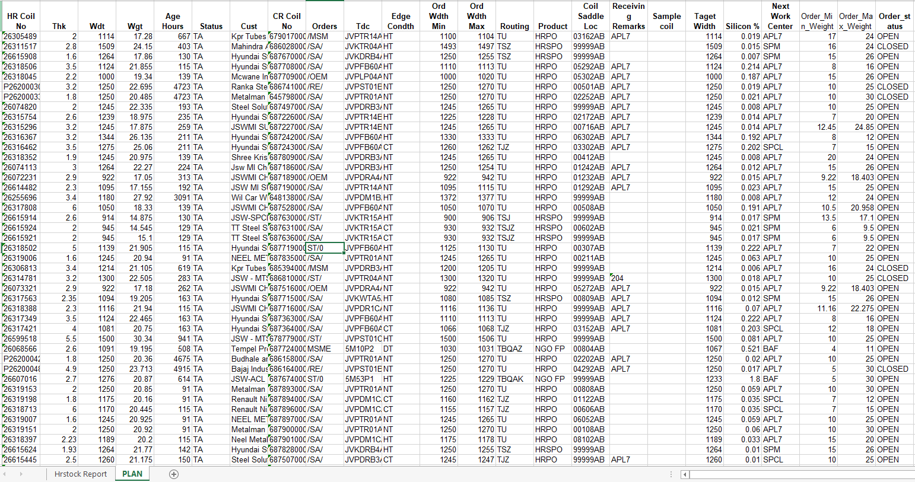
Step 6: Delete all unwanted columns
Required Columns for scheduling

Slide 6
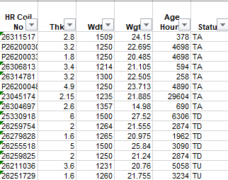
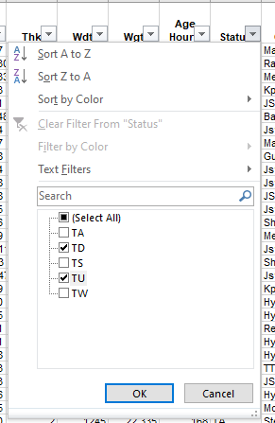
Step 7: Select Status & filter TD & TU
Select TD & TU, remove

Slide 7
Step 8: Only TA & TW

Slide 8
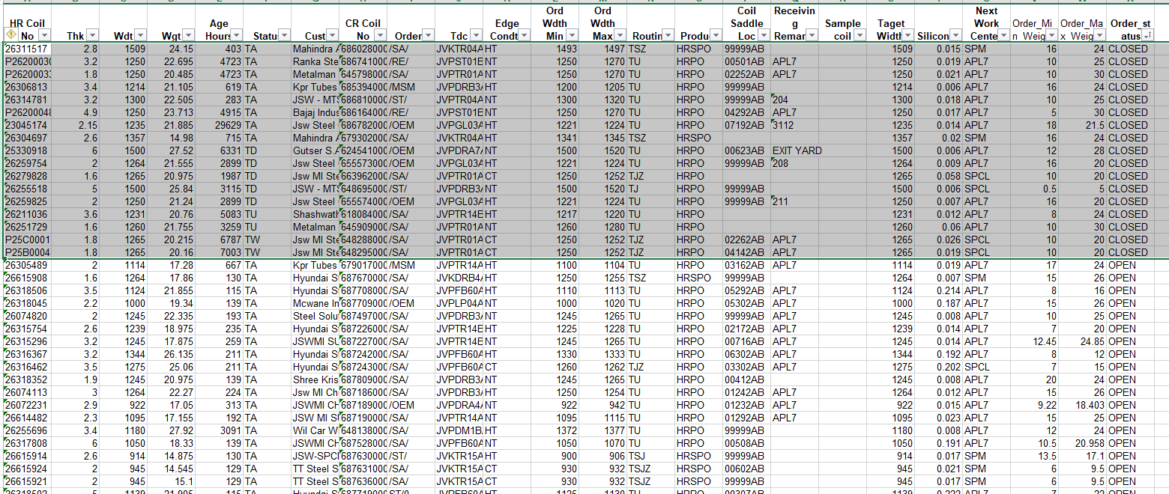
Delete these selected rows, from order status column
Step 9: From order status column, delete all closed

Slide 9
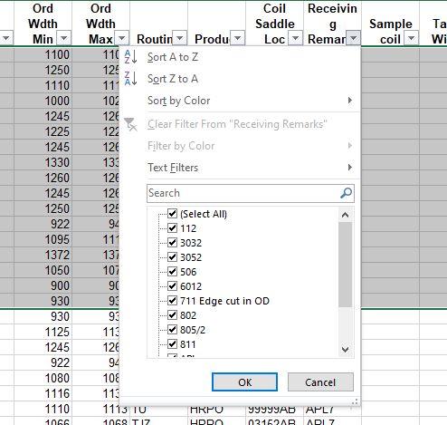
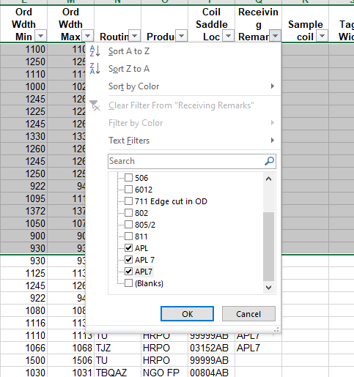
Step 10: From Receiving remarks, Select drop down arrow & select only APL7
Scroll down to find APL7
Select only APL7

Slide 10
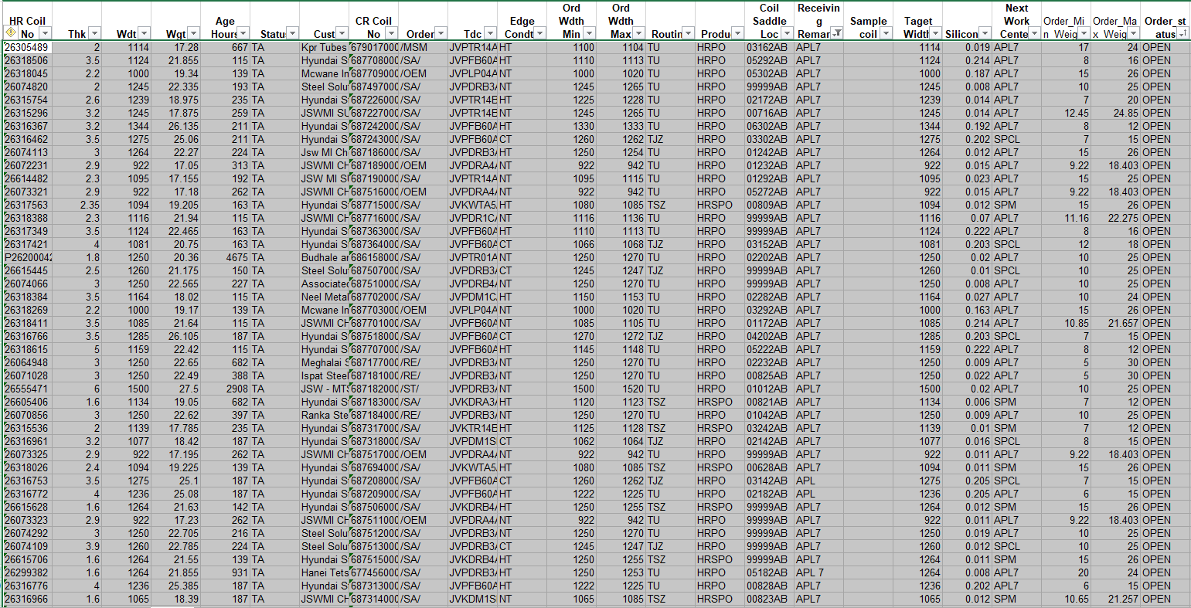
Step 11: Copy & paste in a separate excel sheet

Slide 11
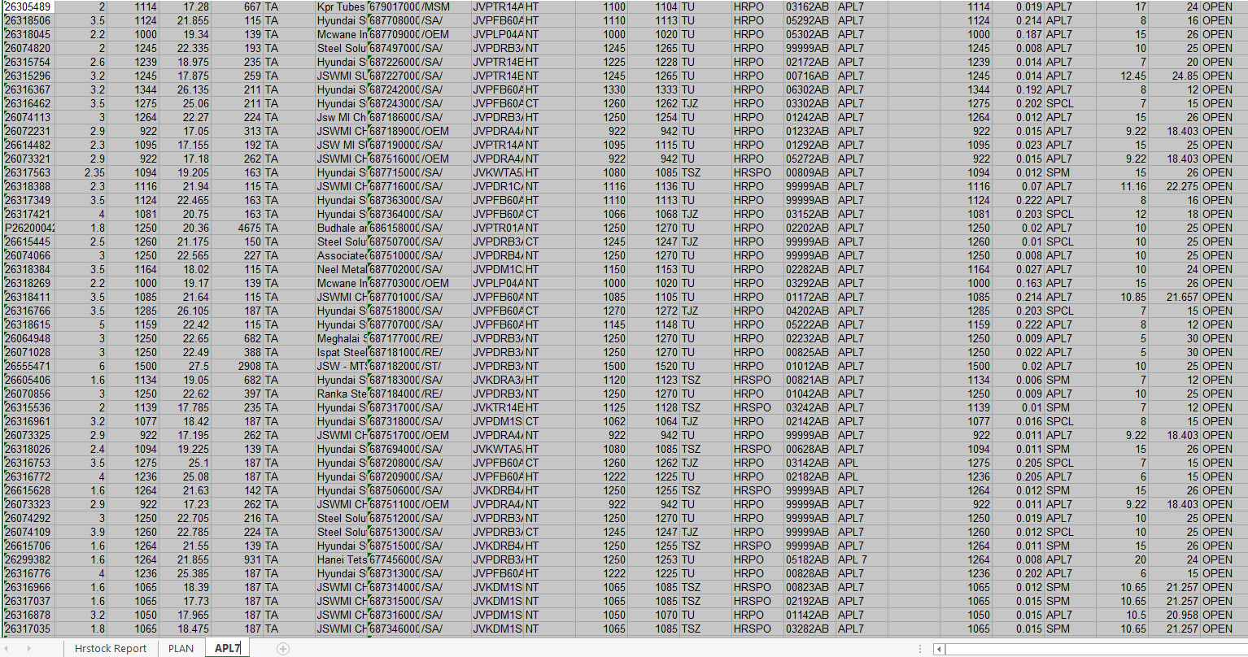
Step 12: Paste the Copied APL7 list in APL7 sheet

Slide 12
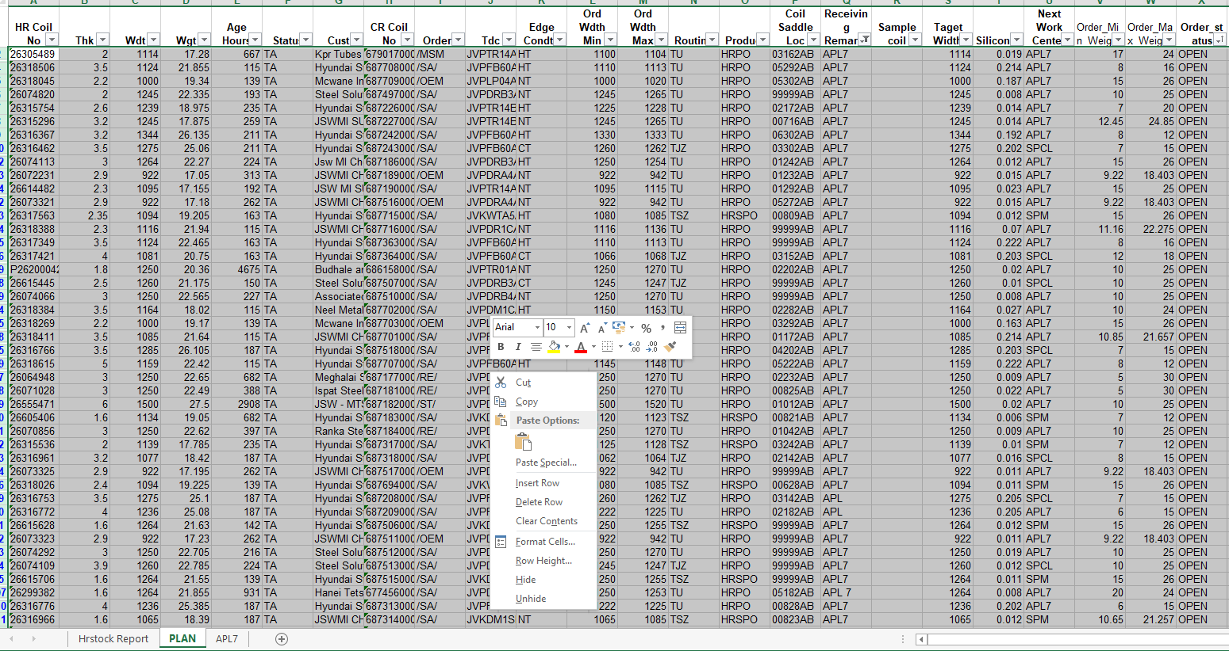
Step 13: Delete the APL7 list in PLAN sheet
Delete the APL7 rows

Slide 13
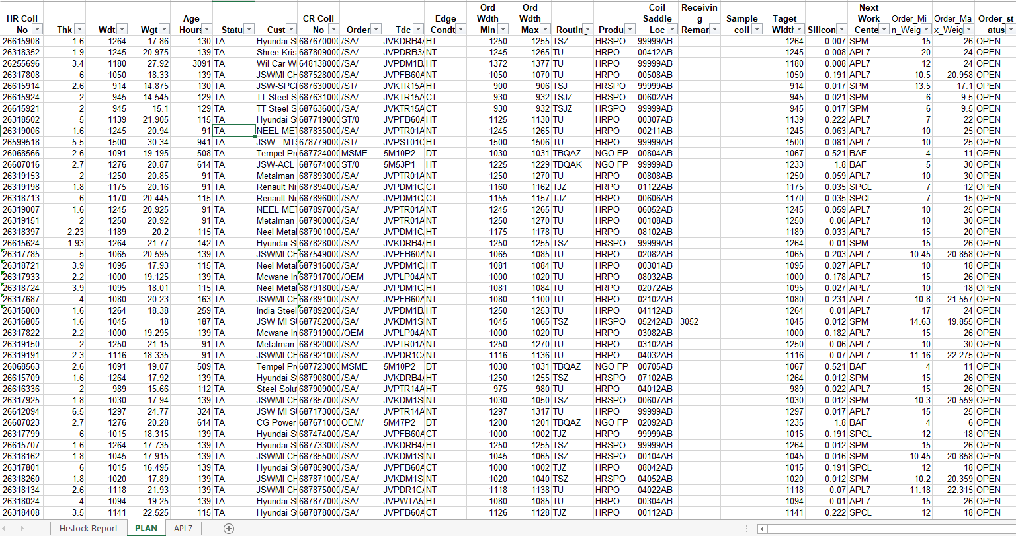
Step 14: Final Schedule data

Slide 14
Scheduling Rules :
For HRPO/HRSPO Product :
Thickness Difference should be <=1mm.(Thickness range of 2 to 6mm)
In Thinner gauge thickness difference should be 0.4mm(i.e, 1.6-2.0mm)
Width Difference should be less than 250 to 300mm( 2 to 6mm).
Above 4.5mm thickness critical TDC of JVPST01C00, JVPFB60AJS, JVPTR14AJS, JVPTR15AJS, JVPTR13AJS should NOT be planned continuously.
Width difference should be <150mm in below 2.0mm coils.
Consider Age hours above 72hours only.

Slide 15
Parameters for Scheduling
Scheduling Rules :
For NGOFP Product :
Silicon Grdae with welding combination
 | Silicon % | 0.45 % Max | 0.9 % Max | 1.3 % Max | 1.55 % Max | 1.7 % Max | 2 % Max | 2.2 % Max | 2.6 % Max
 | Grades | LSQ2L | MSQ1 | MSQ2 | MSQ3 | HSQ1 | HSQ2 | HSQ3 | HSQ5
Grades | Silicon %
LSQ2L | 0.45 % Max | YES | YES | YES | YES | YES | NO | NO | NO
MSQ1 | 0.9 % Max | YES | YES | YES | YES | YES | NO | NO | NO
MSQ2 | 1.3 % Max | YES | YES | YES | YES | YES | YES | NO | NO
MSQ3 | 1.55 % Max | YES | YES | YES | YES | YES | YES | YES | NO
HSQ1 | 1.7 % Max | YES | YES | YES | YES | YES | YES | YES | YES
HSQ2 | 2 % Max | YES | YES | YES | YES | YES | YES | NO | NO
HSQ3 | 2.2 % Max | NO | NO | NO | YES | YES | NO | NO | NO
HSQ5 | 2.6 % Max | NO | NO | NO | NO | YES | NO | NO | NO

Slide 16
NGOFF SAMPLE PLAN
+A1:W26I | Loc |  | HR Coil No | Thk | Wdt | Wgt | CR Coil No |  |  | Age Hours | Status | Cust | Ord Crgrade | Silicon % | Grade | Edge Condth | Ord Wdth Min | Ord Wdth Max | Routing | Product | Taget Width | Next Work Center
 |  | hrpo | 26319455 | 2 | 1150 | 17.89 | 6879850000 |  |  | 86 | TW | Metalman Auto Pvt Ltd |  |  | JVPTR14AJS | NT | 1150 | 1170 | TU | HRPO
 |  | hrpo | 26616451 | 2.7 | 1150 | 21.08 | 6880050000 |  |  | 124 | TA | JSW MI SUBCON PUNE |  |  | JVPDM1AAJ0 | NT | 1150 | 1170 | TU | HRPO
1 | 111 |  | 68H00075 | 2.7 | 1140 | 18.73 | 6876250000 | 0.1 | 59 | 6712 | TW | JSW-ACL Unplanned | MSQ3 | 1.62 | JVHEMC1D00 | HT | 1135 | 1139 | TBQAK | NGO FP | 1140 | BAF
2 | 107/2 |  | 68H00037 | 2.6 | 1081 | 17.38 | 6880310000 | -0.1 | -104 | 2871 | TA | JSW-ACL Service Center | HSQ3 | 2.22 | JVHEHC1H00 | HT | 1070 | 1076 | TBQAK | NGO FP | 1081 | BAF
3 | EXIT YARD |  | 68H00056 | 2.7 | 1185 | 14.66 | 6871780000 | 0.7 | 80 | 664 | TA | Marubeni Itochu Steel India PVT. LT | HSQ1 | 1.74 | JVHEHA1H00 | DT | 1150 | 1151 | TBQAZ | NGO FP | 1185 | BAF
4 | 7102 |  | 67H00122 | 2 | 1105 | 18.035 | 6789180000 | -0.7 | 0 | 1486 | TW | JSW-ACL Service Center | HSQ3 | 2.24 | JVHEHC1A00 | HT | 1115 | 1121 | TBQAK | NGO FP | 1105 | BAF
5 | 8012 |  | 67H00129 | 2.7 | 1105 | 17.995 | 6793630000 | 0.7 | 0 | 906 | TW | JSW-ACL Service Center | HSQ1 | 1.8 | JVHEHA1H00 | HT | 1098 | 1104 | TBQAK | NGO FP | 1105 | BAF
6 | 1102 |  | 67H00119 | 2 | 1105 | 17.97 | 6791290000 | -0.7 | -121 | 1486 | TW | JSW-ACL Service Center | HSQ3 | 2.24 | JVHEHC1A00 | HT | 1115 | 1121 | TBQAK | NGO FP | 1105 | BAF
7 | 604 |  | 68H00082 | 2.7 | 1226 | 18.805 | 6876110000 | 0.1 | 41 | 1984 | TA | Vijya Manufacturing CO. PVT. Ltd . | HSQ1 | 1.73 | JVHEHA1H00 | DT | 1205 | 1206 | TBQAZ | NGO FP | 1226 | BAF
8 | 109/2 |  | 68H00071 | 2.6 | 1185 | 20.08 | 6880300000 | 0 | 120 | 1294 | TA | JSW-ACL Unplanned | LSQ2 | 0.65 | JVHELC1DH0 | HT | 1170 | 1174 | TBQAK | NGO FP | 1185 | BAF
12 | EXIT YARD |  | 68H00113 | 2.6 | 1065 | 19.04 | 6880260000 | 0 | 3 | 469 | TA | JSW-ACL Service Center | LSQ2L | 0.53 | JVHELC2HT0 | HT | 1048 | 1054 | TBQAK | NGO FP | 1065 | BAF
13 | 308 |  | 68H00054 | v | 1062 | 14.86 | 6876170000 | 0 | -29 | 525 | TW | JSW-ACL Service Center | LSQ2L | 0.53 | JVHELC2HT0 | HT | 1048 | 1054 | TBQAK | NGO FP | 1062 | BAF
14 | 1022 |  | 26067222 | 2.6 | 1091 | 20.06 | 6880250000 | 0 | 0 | 590 | TA | JSW-ACL Unplanned | LSQ2 | 0.54 | JVHELC2DT0 | HT | 1050 | 1054 | TBQAK | NGO FP | 1058 | BAF
15 | 202 |  | 26069712 | 2.6 | 1091 | 20.28 | 6880240000 | 0 | 0 | 469 | TA | JSW-ACL Service Center | LSQ2L | 0.53 | JVHELC2HT0 | HT | 1048 | 1054 | TBQAK | NGO FP | 1057 | BAF
16 | 104/2 |  | 26069706 | 2.6 | 1091 | 20.105 | 6880330000 | 0 | 0 | 469 | TA | JSW-ACL Service Center | LSQ2L | 0.52 | JVHELC2HT0 | HT | 1048 | 1054 | TBQAK | NGO FP | 1057 | BAF
17 | NA | NA | 26068577 | 2.6 | 1091 | 19.21 | 6880220000 | 0 | 0 | 525 | TA | JSW-ACL Service Center | LSQ2L | 0.58 | JVHELC2T00 | HT | 1048 | 1054 | TBQAK | NGO FP | 1057 | BAF
18 | 804 |  | 26068566 | 2.6 | 1091 | 19.195 | 6877240000 | 0 | 0 | 525 | TA | Tempel Precision Metal Products Ind | LSQ2L | 0.52 | JVHELC2T00 | DT | 1030 | 1031 | TBQAZ | NGO FP | 1067 | BAF
19 | 3092 |  | 26068579 | 2.6 | 1091 | 19.175 | 6880230000 | 0 | 0 | 525 | TA | JSW-ACL Service Center | LSQ2L | 0.58 | JVHELC2T00 | HT | 1048 | 1054 | TBQAK | NGO FP | 1057 | BAF
20 | 705 |  | 26068563 | 2.6 | 1091 | 19.07 | 6877230000 | 0 | 0 | 525 | TA | Tempel Precision Metal Products Ind | LSQ2L | 0.52 | JVHELC2T00 | DT | 1030 | 1031 | TBQAZ | NGO FP | 1067 | BAF
21 | EXIT YARD |  | 26068582 | 2.6 | 1091 | 18.725 | 6875080000 | 0 | 0 | 525 | TW | JSW-ACL Service Center | LSQ2L | 0.58 | JVHELC2T00 | HT | 1048 | 1054 | TBQAK | NGO FP | 1057 | BAF
22 | 103/2 |  | 26068564 | 2.6 | 1091 | 18.33 | 6880320000 | 0 | 0 | 525 | TA | JSW-ACL Service Center | LSQ2L | 0.52 | JVHELC2T00 | HT | 1048 | 1054 | TBQAK | NGO FP | 1057 | BAF
23 | 110 |  | 26069701 | 2.6 | 1091 | 17.175 | 6876230000 | 0 | 0 | 469 | TW | JSW-ACL Service Center | LSQ2L | 0.56 | JVHELC2T00 | HT | 1048 | 1054 | TBQAK | NGO FP | 1057 | BAF
24 | EXIT YARD |  | 26068585 | 2.6 | 1091 | 15.305 | 6875090000 | -0.1 | -149 | 524 | TW | JSW-ACL Service Center | LSQ2L | 0.53 | JVHELC2HT0 | HT | 1048 | 1054 | TBQAK | NGO FP | 1057 | BAF
25 | 210 |  | 26062051 | 2.7 | 1240 | 21.09 | 6876420000 | 2.7 | 1240 | 849 | TW | JSW-ACL Unplanned | MSQ2 | 1.37 | JVHEMB1D00 | HT | 1218 | 1222 | TBQAK | NGO FP | 1226 | BAF

